Slide 1
High performance in react development
Using redux-saga and file-structure in SPA
By Hoang, Vu-le

Slide 2
1. Introduce
1.1. What is file restructure ?
Dan Abramov famously officialized the file structure for React applications as “move files around until they feel right.”
Ways to file structure:
Grouping by features or routes
Grouping by file type

Slide 3
1. Introduce
1.2. Why do we have to restructure files ?
Clear
Clean
Unified
Suitable for each project

Slide 4

1. Introduce
1.3. What will you take ?

Slide 5
2. Code
2.1. Prepare:
Javascript và ES6-ES7
ReactJs
Redux và redux-saga
Axios

Slide 6
2. Code
2.2. Coding
Setup project: npx create-react-app .\file-structure-demo\
Setup package redux-saga: npm i –-save react-redux redux-saga
Setup axios: npm i --save axios
Setup dotenv: npm i --save dotenv

Slide 7
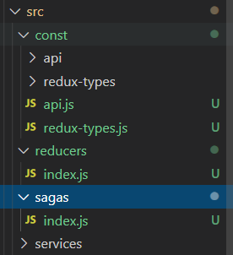
2. Code
2.2. Coding
Const
Reducers
Sagas
Services

Slide 8
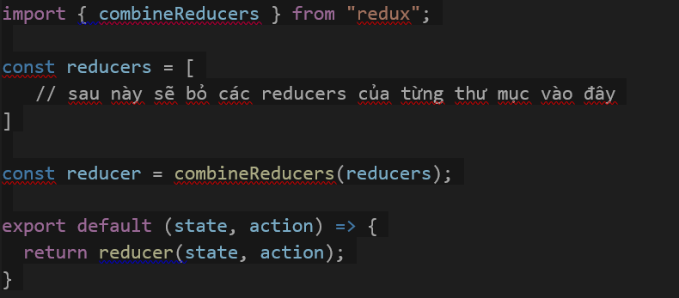
2. Code
2.2. Coding
Setup saga:
reducers/index.js

Slide 9
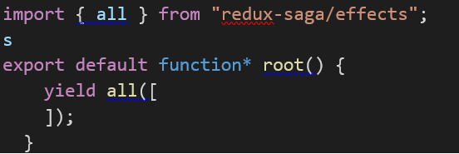
2. Code
2.2. Coding
Setup saga:
sagas/index.js

Slide 10
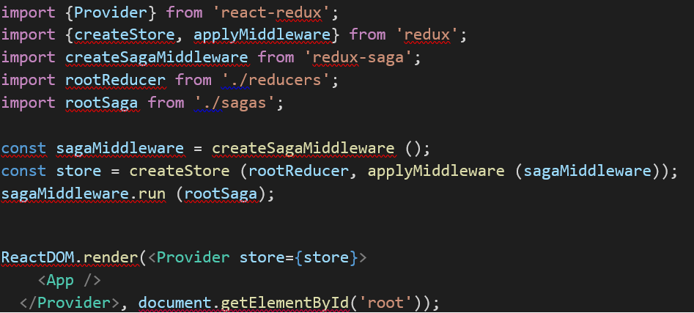
2. Code
2.2. Coding
Setup saga:
index.js (root)

Slide 11
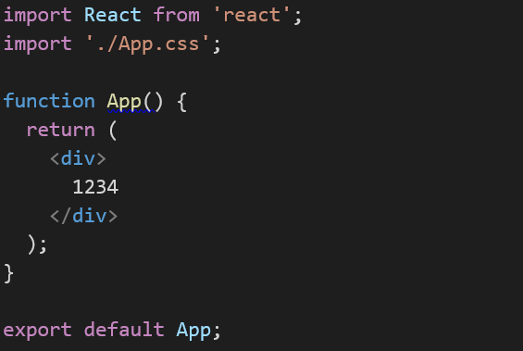
2. Code
2.2. Coding
Setup saga:
App.js

Slide 12
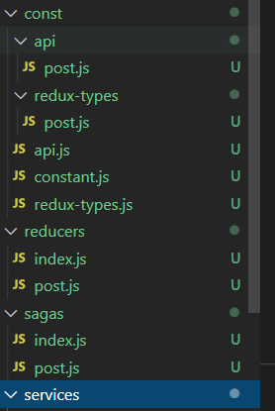
2. Code
2.2. File structure

Slide 13
2. Code
2.2. File structure

Slide 14
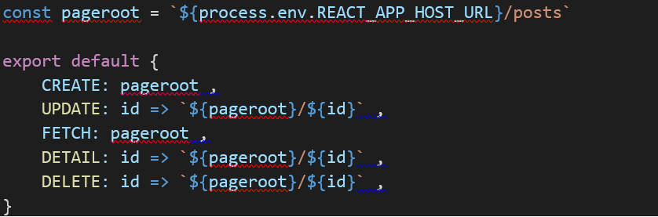
2. Code
2.2. File structure
Api.js:

Slide 15
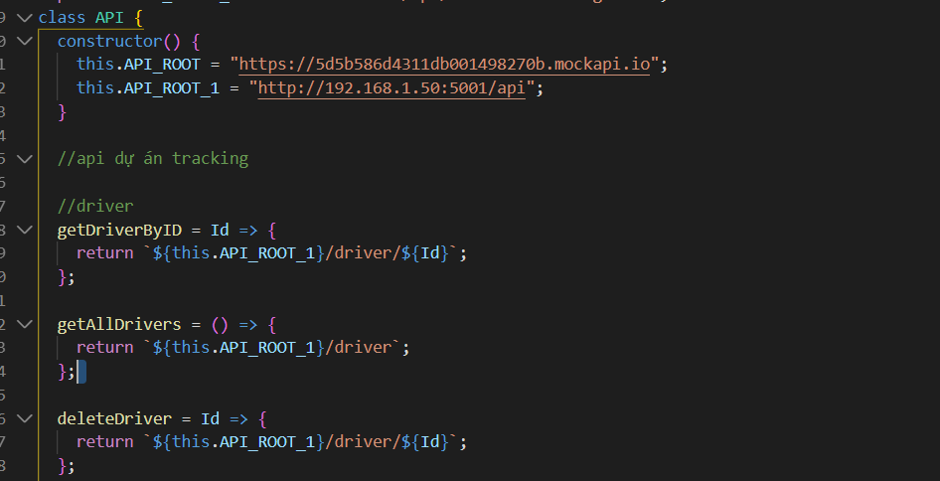
2. Code
2.2. File structure
Api.js:

Slide 16
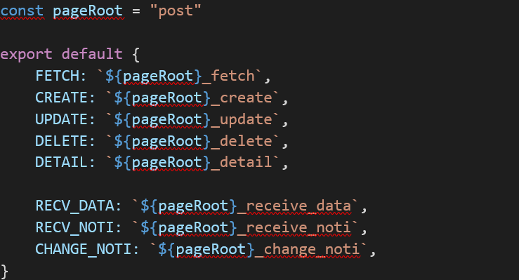
2. Code
2.2. File structure
redux-types.js:

Slide 17
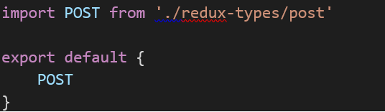
2. Code
2.2. File structure
redux-types.js and api.js
REDUX_TYPES.POST.[………….]

Slide 18
2. Code
File api
File redux-types
File reducer
File saga
File index.js(file giao diện)
File service
File root của api, redux-types, reducer, saga

Slide 19
2. Code
Src: https://github.com/hoangvlbk61/file-structure-demo

